Slide 1
NATIONAL CASE STUDY CHALLENGE
2021
MAVERICKS : Devesh Sinha, Kajal Gupta

Slide 2
TABLE OF CONTENTS
1.
ABOUT US
9.
SWOT ANALYSIS
2.
BRAND EXPRESSION
10.
BUSINESS VALUE PROPOSITION
3.
MISSION AND VISION
11.
CONSUMER BEHAVIOUR
4.
CORE VALUES AND PURPOSE
12.
CUSTOMER SEGMENTATION
5.
PRIMARY RESEARCH
13.
CONSUMER PERSONA
6.
SECONDARY RESEARCH
14.
TARGETING
7.
COMPETITORS
15.
GO TO MARKET STRATEGY
8.
COMPETITIVE BENCHMARKING
16.
ROADMAP

Slide 3
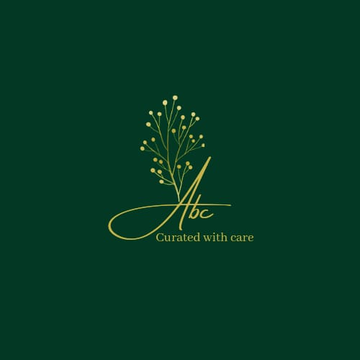
ABOUT US
ABC is a sustainable Indian skincare brand, which makes skincare and hair care products with natural Ingredients.
ABC stands for its use of natural ingredients without any harsh chemicals, additives, synthetic oils, or perfumes.
Our products are non-toxic, not tested on animals, and unadulterated without the use of parabens, sulphates, silicones, synthetic fragrances, and other harmful chemicals.
ABC differentiates itself from the skincare products in the market by producing chemical-free products.
The brand is also personalized and customized for Indian skin and hair.

Slide 4

BRAND EXPRESSION
“We grow , we glow!”
Our Story
We are people just like you .Our (Me and my friend) journey began when my sister told us that she is expecting a baby ,We got so excited that we started looking our old photos .While going through those photos we realized ,the way a baby starts his/her journey by learning English alphabets A , B , C similarly in our journey called life , at each step we too grow old and during this process , our hair and skin gets affected the most , due to varying climatic/work conditions at every point in time without us even recognizing it.
So we wore our spyglasses and did all the possible research. Whoh! we were shocked to see ,how most skin and hair care products say that they are chemical free and are sustainable ,but are actually made by slaughtering animal and are filled with chemical, which were literally harmful for everyone.
We were so worried and sick ,and It was not just about us ,but every other human being ,be it a little baby or our parents .That’s when we decided to do something about it and create products which were safe ,vegan and certified toxin-free. A brand where we grow together , we glow together. A brand which develops products from world-class research and attempts to solve every little problem that we as humans face . With the aim of making products which are Eco-friendly, toxin-free, meet stringent international standards & are basically ultra awesome, ABC was born.

Slide 5


MISSION
Create and provide effective skin care products
Build a unique portfolio of innovative,organic and
eco-friendly products
Strive to be the best in innovation, quality and value
Community building for promotions
Easily accessible
VISION
To be a medium of being humane in the global market by creating a sustainable , holistic business modality, which inspires and supports true weal and respects Mother Nature
Spread Awareness about organic,vegan,eco-friendly products
Provide customized products to encourage confidence and healthy lifestyle

Slide 6
CORE VALUES
PURPOSE
Improve my customer’s health and happiness.
To be ethical and beneficial to the environment and the local community.
Accountability
Carbon Neutrality
Integrity
Environment Friendly
Social Responsibility

Slide 7
PRIMARY RESEARCH
Number of Respondents: 75
Target Age Group: 18-55
About 78% people prefer to do internet search, out of which 50% always do an internet search before buying any cosmetic product.
Body lotion, facial cream and facial cleansers constitute a major chunk of daily skin care products used.
56% respondents believe that organic cosmetics are better in quality than others, while 30% are confused about this.
48% respondents are willing to pay more for organic cosmetics.
Key Findings:

Slide 8




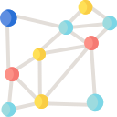







SECONDARY RESEARCH
Market Size
Consumer Spending
Connected Beauty Consumer Report
The global market for Cosmetic industry is estimated at $145.3 Billion in the year 2020, forecasted to reach $185.5 billion by 2027.
Consumer Expenditure(McKinsey,2020)
1740 consumers
18-45 years old
Skin-care, Makeup and Haircare
15%
14%
Market acceleration
CAGR of almost 5%
Growth contributed by APAC: 48%
9 out of 10 consumers are influenced by digital media.
Mode of awareness
Growth for 2020
4.21%
Fragmented market with several players
Makeup
Personal care
Emerging platform for beauty advisors, 81% of them engage with beauty creators on YouTube
26% have purchased a beauty product as a result of watching a beauty video on YouTube
56% consumers use YouTube to compare and consider
30% reach their final decision are made through a mix of YouTube, Google search and E-commerce websites
CAGR 5.91%
Consumer spending stood at $236.94 billion in October 2016, has increased to $309.46 billion in January 2020.
Body care products such as hand cream, body lotion ,that led the market with share of 45.01% in FY2020 , is forecasted to grow well.
Indian cosmetics industry currently stands at ₹73,000 crore
2017
2030
An increasing number of consumers are shifting towards better quality natural products like organic personal care items, which is expected to continue boosting the market in the coming years.
Source: Intelligence,2020
2/3 rd. of the total consumers surveyed admitted not being loyal to one brand.

Slide 9






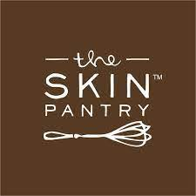






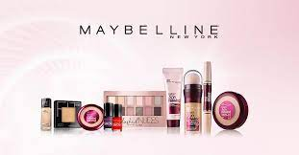




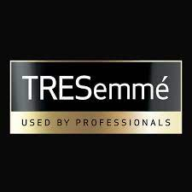




Direct Competitors
Potential competitors
Competitors
Partial Competitors

Slide 10


COMPETITIVE BENCHMARKING
Major Competitors | Types of Products Sold | Revenue | Product Specs | Target Audience | Specific campaign/Product launched
 | Baby,beauty,body,hair,face | 112 Cr FY2020 | Toxin-Free, pH Balanced | Millenials(22-45) | Plant trees for every product bought. Purpose: ‘Goodness inside’
 | Face, Body, Hair, Aromatherapy | 6.25 Cr FY 2020 | Organic | All having relevant problems | Shop by Concern; Tagline: ‘Organic by Nature’; Mostly word of mouth promotions; COSMOS v3 standards ECOCERT certified
 | Hair conditioner,Aloe vera Soap,Herbal Face Wash | $5 million FY2020 | Herbal products | Millenials | KVIC registered; natural herbal care
 | Skin,hair,body, natural makeup,beauty advice | $29 million FY2020 | Ayurveda, Organic | 18-35 year old, hotels and spa | BIOTV; Boutique's digital business is growing by over 200 percent. The company exports to over 200 countries and recently launched a range of products for children in partnership with Disney.

Slide 11









SWOT ANALYSIS
Industry Analysis
Company Analysis
Strengths:
Innovative product catalogue to cater to insatiable consumer demands.
Diverse product portfolio with premium quality.
Chemical-free, vegan, unadulterated, environmental-friendly products.
Commitment through Environmental, Social and Governance (ESG) funds to cater to environmental and social needs.
Rapid growth rate, forecasted to cross $30 billion by 2025.
Young demographics and improving standard of life.
Increase demand of cosmetic products.`
Perfectly competitive market.
Price-conscious consumers.
Inflation and economic depression.
S
Weakness:
No brick-and-mortar stores.
Limited/no presence in the premium cosmetic market, hence, low market share.
W
High population of millennials and gen Z.
Emerging markets due to unexplored areas.
Entry to new and less accessible markets due to high online reach.
Competition from global market.
Uncertain regulation due to political. interventions/influences.
Consumers concerned about environmental impact.
Brief shelf life of organic personal care and cosmetics.
Opportunities:
Growing demands in natural/organic cosmetics.
Increase in Personal Disposable Income/ per capita income.
Using various mediums of communication for product promotion and visibility.
Tie-ups with beauty chains/ salons.
O
Threats:
Intense competition from global and local brands.
Not certified by any cosmetic regulatory board.
Counterfeit products might hamper brand image.
T

Slide 12
BUSINESS VALUE PROPOSITION
Wide Product Portfolio
Affordable Products
24*7 Support to get in touch with all your queries
Social Responsibility,
Commitment to ESG
Vegan, Chemical-free, Environment-Friendly, Sustainable
Customised Products after proper consultation with the respective consultant
Virtual trials through AI

Slide 13
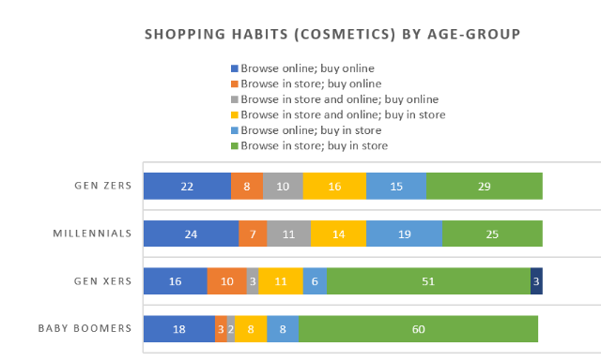

CONSUMER BEHAVIOUR
Recognition of Problem
Search for information
Evaluation of alternatives
Purchase Decisions
Outcome
Age and Lifecycle
Income and Occupation
Lifestyle
Personality
Psychological Perception
Social Factors
Factors affecting buying decisions
Factors having correlation with consumer behaviour towards cosmetics
Brand
Quality
Price
Advertisement
Social Status
Trust
Previous Experiences
Durability
Packaging
Information/Awareness
Product Assurance
Organic
According to the Connected Consumer Report, 2/3rd of the total consumers surveyed admitted not being loyal to one brand. Therefore, brands with easy-to-find information on digital are more likely to make it to the consumer shortlist.

Slide 14
CUSTOMER SEGMENTATION
Customer Segmentation
Demography
Geography
Behavioural
Psychographic
Age
Gender
Mobility
Income
Climate
Urban
Rural
Purchase Behaviour
Occasion
Benefit Sought
Loyalty
Satisfaction
AIO
Personality
Lifestyle
Social Status
Attitudes

Slide 15


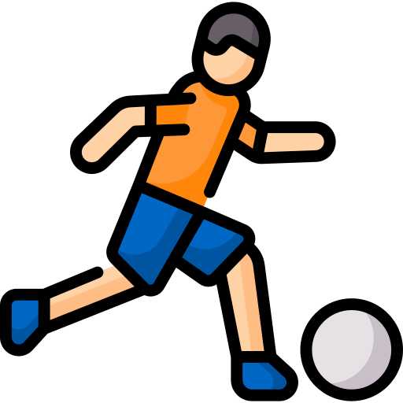




CONSUMER PERSONA
Persona : Cares for sensitive skin
Age : Toddlers and tweens
Pain Points : Irritations , dry/cracked skin
Persona: School going kids
Age : 12 – 17
Pain Points : Rough skin , overexposure to sun , hair fall , skin allergies
Persona : Sports / Athletic Professionals
Age : 18 - 24
Pain Points : Sweating , tanning
Persona : College Students
Age : 18 - 24
Pain Points : hair fall, exposure to sun, acne, improper nourishment of skin
Persona : Working Professionals
Age : 25 - 45
Pain Points : Tried multiple skincare / body products but were ineffective due to a travelling job role.
Persona : Preggers / Post Preggers
Age : 25 - 45
Pain Points : Dark circles , under eye swelling , hair issues
Consumer concerns: Major concerns being, the products when used, may lead to some side-effects/ allergies.

Slide 16
TARGETING BASED ON CONSUMER BEHAVIOUR
Segment Name | Benefits sought | Behavioural Characteristics | Personality Characteristics | Lifestyle characteristics | Targeting
The Vanity buyer | Brand | User of high end brands | High sociability | Image conscious | Collaboration with celebrities
The Attribute buyer | Attribute benefits like spotless skin | Result Oriented | Ambitious | Active | Through reviews and testimonials on the social web
The Price sensitive buyer | Affordability | Heavy users | High autonomy | Value oriented | Strategic pricing depending on quantity
The Fussy buyer | Suitability to skin type | Trial users | Self involved | Perfectionist | Giveaways and personalised ads
The Lazy buyer | General purpose | Medium to heavy user | Laid back | Hedonistic | One click destination to payment page
The Inquisitive buyer | Special ingredients for glowing skin | Look for search qualities | Analytical | Conservative | 24*7 support along with a consultant(if required) to solve their queries

Slide 17
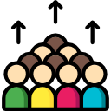



PRODUCT BASED CUSTOMER TARGETING
Mass Marketing
Based on Age Group
Toddlers and tweens, require basic daily care products like Body massage oil, hair oil, soap, moisturiser, shampoo.
Other than daily care products,12-17-year-olds, require lip balms, sunscreen and body wash as well.
18–24-year-olds, need Cleanser, Toner, serum, sunscreen, body wash apart from the daily care products.
25-45 year olds, need all the variety ranging from skin care to hair care depending on various circumstances.
Daily needs cosmetic product like shampoo, hair oil, soaps, moisturizer, conditioner to cater to every household.
Geography
Behavioural
Depending on changing climatic conditions, consumer require different skin/hair/body care products.
Hot: Sunscreen, hydrating gel, face mask, lip balm
Cold: Moisturiser, body butter, hair oil
Humid: Soap/body wash, hair serum, hair mask, sunscreen
Occasion
Work:
Travelling frequently: Sunscreen, cleanser, toner, lip balm, body wash, face mask
Travelling once-in-a-while: Sunscreen, face mask, moisturiser
Working remote: eye creams, hydrating gel
Social gatherings/Festivals:
Cleanser, toner, serum, moisturiser, hair mask, hair serum, lip balm, face mist

Slide 18






GO TO MARKET STRATEGY
Launch
Pan India launch of App and Website
Community Campaigns
Mass and Targeted media
Product promotions in areas with high footfall.
Advertising Outbound- TV, Radio
Advertising Inbound- Digital, search
Public Relations
Personal and Interpersonal Means
Salesforce, Word Of Mouth, Referrals
Social Media Influencers, Brand Campaigns

Slide 19
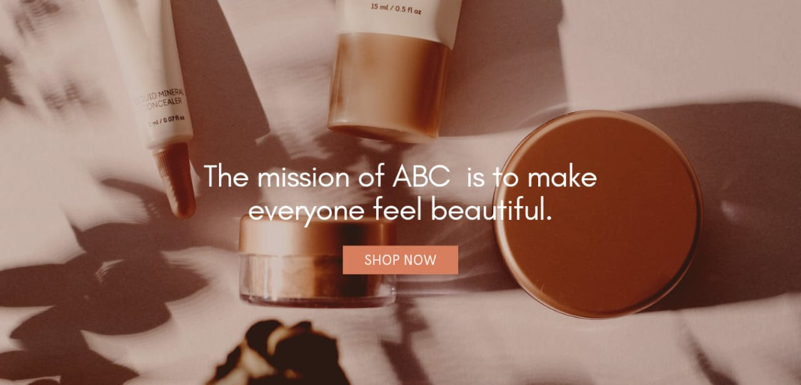



ABC APP/WEBSITE
The ABC App:
Choose products from our wide product portfolio using our website / app.
Get detailed information about ingredients used in each product.
Signup and order to get a virtual shopping experience.
24*7 support for customer queries.
Subscribe to our blogs and articles.
SIGN UP FOR A NEW ACCOUNT
Email Address
Password

Slide 20








GO TO MARKET STRATEGY
Outbound Advertising
Inbound Advertising: SEARCH
TV Promotions at peak viewing hours at multiple channels having larger viewership.
Website Development:
Website to be developed so as it appears in maximum searches.
Content Development for SEO:
Rich Content Marketing for maximum appearances in search.
Paid promotions on radios with RJ’s initiating conversations about our products and services with the guests and the listeners.
10 Lakh clicks
20 Lakhs CPC Units
Radio promotions through contests, with winners getting gift hampers.

Slide 21






SOCIAL MEDIA PROMOTIONS
Connecting with beauty pageants/influencers.
Sending personalised mails through InMail.
Promotions through groups and blogs.
Promotions through creating a business website of ABC Cosmetics.
Promotions through Facebook stories.
Online quizzes with winners getting gift hampers.
Engagement through groups for increasing market presence.
Live events for customer interaction.
Reposting the reviews for brand building.
Set up a Business account.
Promotions through Instagram reels and posts to increase follower base.
Promotions and know-your-skin trivia through stories.
Use hashtags for maximum reach.
Using “@influencer” to the shoutout to the influencer.
Using the shopping on Instagram to redirect to App/Website.
Data Acquisition through App/Website to pitch personalised products via mails.
Sending Blogs/newsletters/articles promoting valuable and relevant consumer concerns.
Providing ‘How-to’ tutorials along with video links.
Invitation for campaigns for local/virtual events.
Business page for Quora promotions.
Commenting answers for maximum reach.
Prepare a questionnaire and the answers which are relevant to the product line for maximum reach.
Create Channel with eye-catching thumbnails.
Creating valuable content with eye- catching thumbnails for the consumers to increase subscriber base.
Product tutorials with links redirecting to app/website.
Set up a Business account.
Creating boards with different product catalogues.
Creating infographic blogs to feature on top Pinterest searches.
Promoting valuable content to increase follower base.

Slide 22

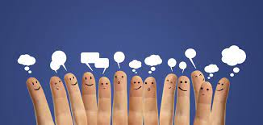
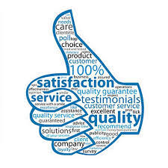
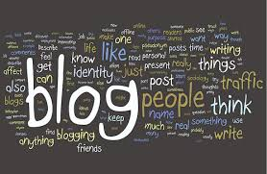
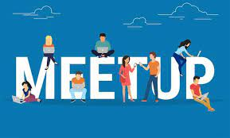

CUSTOMER ENGAGEMENTS
Collaborations and Empowerment amongst Customers
Customer Feedback
Promoting diversity using the comment section.
Consumers replying to the fellow consumers providing her with a supportive and encouraging community.
Having online forums where the customers can exchange their views on the products and recommend various other products.
Having virtual meet-ups/live chats with the customers to provide a better understanding of the products.
Providing exclusive blogs to give users a personal feel of the product and increase social media engagement.
Reposting positive feedback to have deeper interaction with followers, increased brand loyalty and increase perception of brand expertise
Live webinars , to help customers interact with the brand, through email ,forms and interviews.

Slide 23
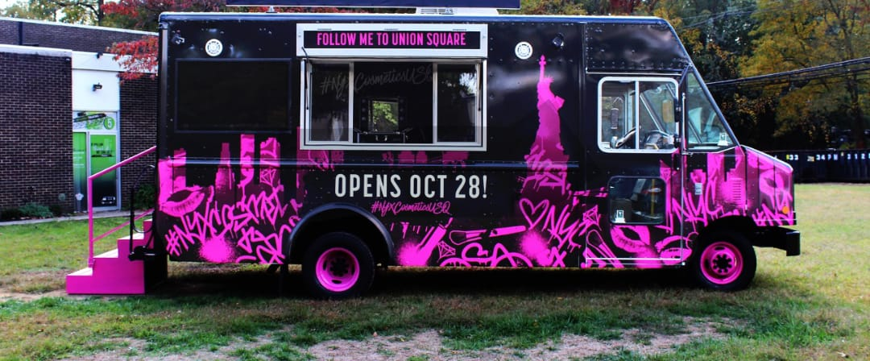
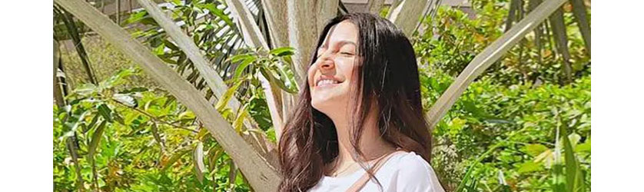

CELEBRITY ENDORSEMENT AND CAMPAIGNS
Community Campaign
Celebrity Endorsement
Launching massive marketing campaign backed by offline showrooms , pop-up shows , and even vending trucks.
Promoting our newest cosmetic products using a vending truck.
Targeting customers at the locations where the footfall is high.
Anushka Sharma as the brand ambassador
Stands up for animal rights and environment issues.
Has a huge fan following base.
Is blessed with a baby girl recently, the brand message resonates.
Building brand awareness instantly.
Product or brand easily recallable.
To enhance market value and capitalisation.
Increase credibility.
Spread brand message to attract new users.
Positioning the brand by influencing consumer decision.
Influencer Marketing
Brand identity
Brand Campaigns
‘Rejuvenate with Nature’ in collaboration with celebrities and social media influencers.
Collaboration with Humane Society International in support of exploitation against animals.
Brand Loyalty
Audience
Building
Lead Generation

Slide 24
ROADMAP
Research
App/Website
Marketing
Sales
Degree of Diversification
Build Prioritisation Model
Targeted Content
Cold Calling
Critical Success Factors
React Framework
Advertising, Promotions & Collaborations
Engage Key Vendors
T1Y1
Evaluate opportunity/ value proposition
App/Website Launch
Setup Conversion Tracking
Define Territories
Evaluate Community Management Platforms
Profit Opportunities
Usage Analytics
Build Customer Personas and Use Cases
Analyse trends
Demand-Supply Mechanics
Transaction System Improvements
Launch Coupon Offer #1
Feedback Touchpoints
T2Y1
Competitor Analysis
UI/UX improvement
Optimize Promotions & Ads
Connect with Distribution Networks
3rd party Integration
Strategies to expand niche segments
Analyse Trigger Points
Influencer Platform
Salesforce/Lead Square/Any other CRM software
Potential Entrants
3rd party Integration
Launch Coupon Offer #2
Feedback Touchpoints
T3Y1
Analyse business cycle sensitivity
Optimize Promotions & Ads

Slide 25
THANK YOU!!

